Slide 1
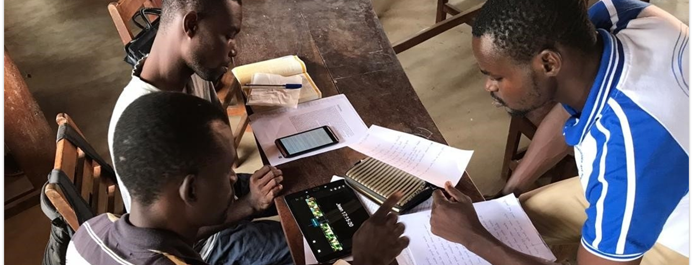
I will praise You, for I am fearfully and wonderfully made; marvelous are Your works, and that my soul knows very well (Ps. 139:14).
All Scripture is taken from the New King James Version®. © 1982 by Thomas Nelson, Inc. Used by permission. All rights reserved.
Why MAST Works

Slide 2
Cone of Experience
Read it 10%
Hear about it 20%
Watch others show it 30–50%
Participate in speaking of it 70%
Speak and write to analyze it 70–90%
Create something (like a full translation) 90+%
More comfortable
More skilled
Able to teach
Quicker

Slide 3
“Also it shall be, when he sits on the throne of his kingdom, that he shall write for himself a copy of this law in a book, from the one before the priests, the Levites. 19 And it shall be with him, and he shall read it all the days of his life, that he may learn to fear the Lord his God and be careful to observe all the words of this law and these statutes
Deuteronomy 17:18–19

Slide 4
Cone of Experience
Read it 10%
Hear about it 20%
Watch others show it 30–50%
Participate in speaking of it 70%
Speak and write to analyze it 70–90%
Create something (like a full translation) 90+%
Consume
Verbalize
Chunk
Blind Draft
More comfortable
More skilled
Able to teach
Quicker

Slide 5
Sense and Meaning
Both pictures make sense.
Which is more meaningful to you?
Why?

Slide 6
Sense and Meaning
Both pictures make sense.
Which is more meaningful to you?
Why?
Consume
Verbalize
Chunk
Blind Draft
sense
meaning
meaning
meaningful information retained

Slide 7

How many triangles?

Slide 8
Connecting the Dots
How many triangles?
In Steps 5–8 (checking steps), we ask:
Have we added information?
Have we made assumptions?

Slide 9


Timing and Memory
Short-term memory
Working memory
Long-term memory
Step 1 Consume
Short-term memory
5–7 minutes
Steps 2 and 3, Verbalize and Chunk
Working memory
7–10 minutes
Step 4, Blind Draft
Steps 5–8, Checking steps
Long-term memory
More time

Slide 10
Lateralization
Using both sides is best
Logical thought
Math and science ability
Seeing details
Planning and putting things in order
Logic
Vision on right side
Control of actions on right side
Emotional thought
Ability to do creative work
Seeing the “big picture” of how everything works together
Adventurous impulses
Imagination
Vision on left side
Control of actions on left side

Slide 11
Lateralization
MAST Steps use both sides
Left-side steps Right-side steps
Consume
Chunk
Self-edit
Peer-edit
Verbalize
Blind draft
Key word check
Verse-by-verse check

Slide 12

Higher-level Thinking
How can you improve the pencil?
Does a pencil work for every writing need? Why or why not?
Why would you use a pencil instead of a pen?
What else could it be used for?
What does it do?
What is it?

Slide 13
